Slide 1
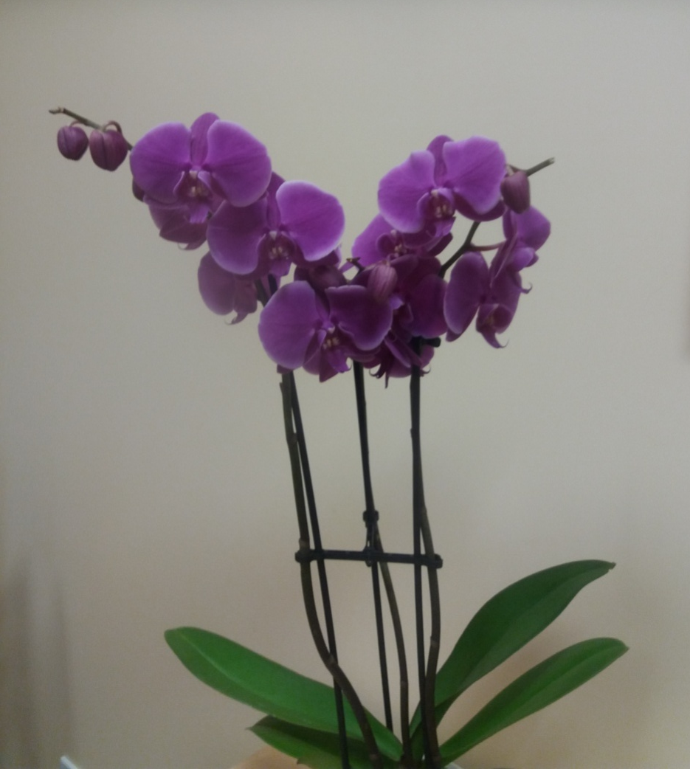
Claudine
Claudina

Slide 2
Solidarity
Solidarité
Solidaridad

Slide 3
Forgiveness
Perdón
Pardon

Slide 4
Sabiduria
Wisdom
Sagesse

Slide 5
Ternura
Tenderness
Tendresse

